Slide 1
Fully Paid Loan Analysis
DASC 1223H
Dr. Schubert
By Team 2: Ethan Ericson, Harvy Maza, Andrew Mendez, and Ethan Styles.
Notes:
Ethan Styles

Slide 2

Goals
How can we improve applicants who are unlikely to succeed?
What indicates a good borrower?
Notes:
Ethan Styles

Slide 3
Hypotheses
We hypothesized that the following variables would indicate someone’s ability to fully pay off their loan.
Loan-related Factors
Loan Amount
Interest Rate
Credit History
Number of Delinquencies/Derogatory
Public Records
Personal Demographics
Homeownership Status
Verification Status
State
Financial Indicators
Annual Income
Debt-Income Ratio
Employment Length
Harvy
Andrew
Ethan S.
Ethan E.
Notes:
Ethan Styles

Slide 4
Data Set Overview
Notes:
Ethan Ericson

Slide 5
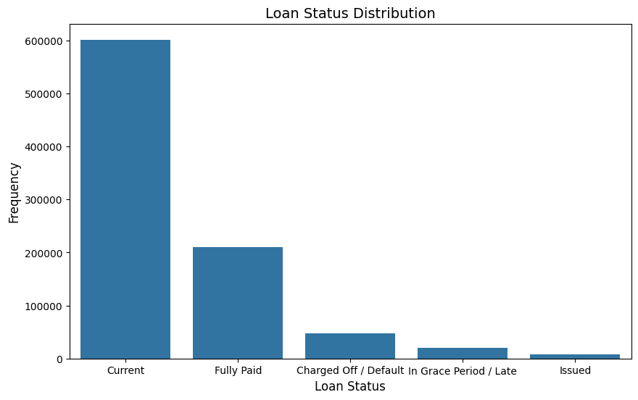
Loan Status Overview
Loan Status: The majority of loans are current loans, then fully paid.
Statuses: Fully Paid are borrowers that fully pay off their loans, Charged Off / Default are borrowers that fail to do so.
Notes:
Ethan Ericson

Slide 6
Loan Related Factors
Notes:
Andrew

Slide 7


Loan Amount Impact on Payment Status: Exploring the Relationship
Importance:
It can help determine if borrowers with larger initial loan amounts are likely to default compared to those with smaller loan amounts
Making Connections:
Loan Amount Payment status (repayment ratio), and default rate.
Interest Rates and Repayment ratio
Interest and Default Rate.
Notes:
Harvy

Slide 8
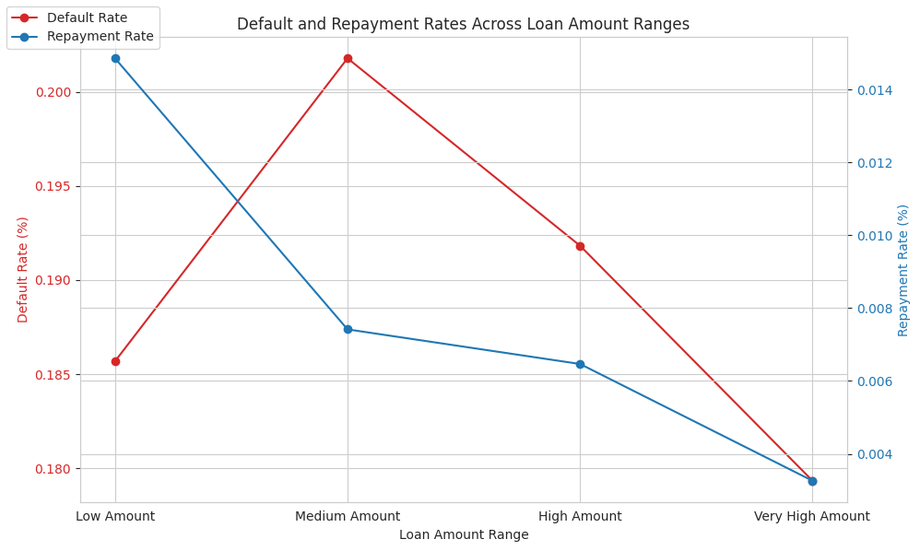
Notes:
Harvy

Slide 9
Repayment Likelihood and Loan Amounts: Implications for Lending Strategies
This information helps in the identification of reliable borrowers by:
1. Recognizing the inverse relationship between default and repayment rates
2. Observing the trend which indicates that risk escalates with loan amount​
3. The impact on repayment likelihood diminishes as loan amounts increase.​​
The decreasing repayment rate across higher loan amount ranges underscores the potential challenges borrowers may face in managing and repaying larger loans
Notes:
Harvy

Slide 10
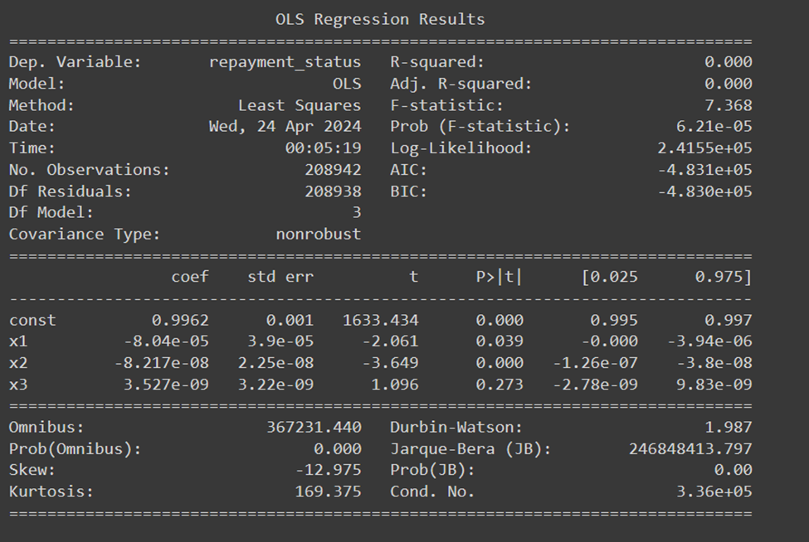
Regression model
While the overall model performance indicates minimal variance explanation, individual coefficients offer nuanced understandings.
Notes:
Harvy

Slide 11
Regression Model Statistics
The findings from the regression model provide valuable insights into the characteristics of clients and their loan repayment behavior, informing tailored lending strategies.
Default Rate: 5%
Repayment Rate: 95%
Average Loan Amount: $10,000
Average Interest Rate: 8%
Understanding client characteristics and their implications for loan repayment involves considering a comprehensive range of factors beyond the variables examined in this analysis.
Notes:
Harvy

Slide 12

Highlights from regression Model
Our Regression statistic model provide us multiple key findings about our Fully Paid borrowers’ behavior:
Moderate Loan Amounts
High Repayment ratio
Low default rate
Reasonable Interest Rates
These characteristics collectively demonstrate that good borrowers exhibit responsible financial behavior and manage debt effectively, making them reliable candidates for lending institutions.
Notes:
Harvy

Slide 13
Credit History
Notes:
Andrew

Slide 14
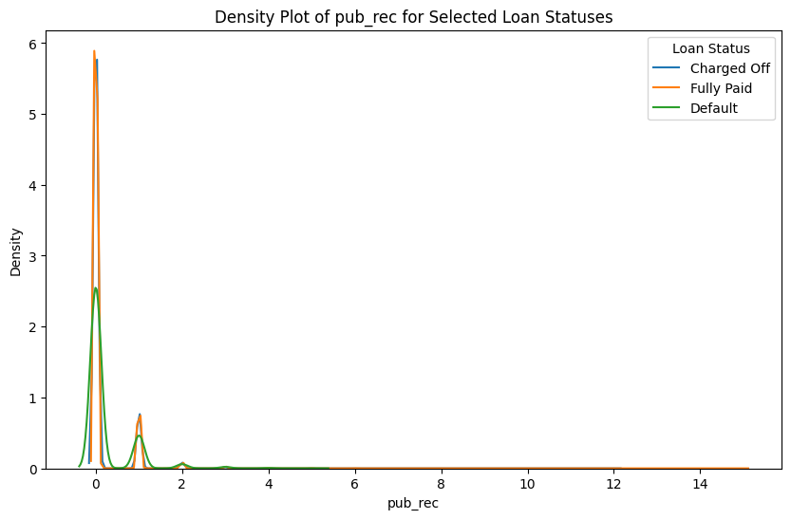
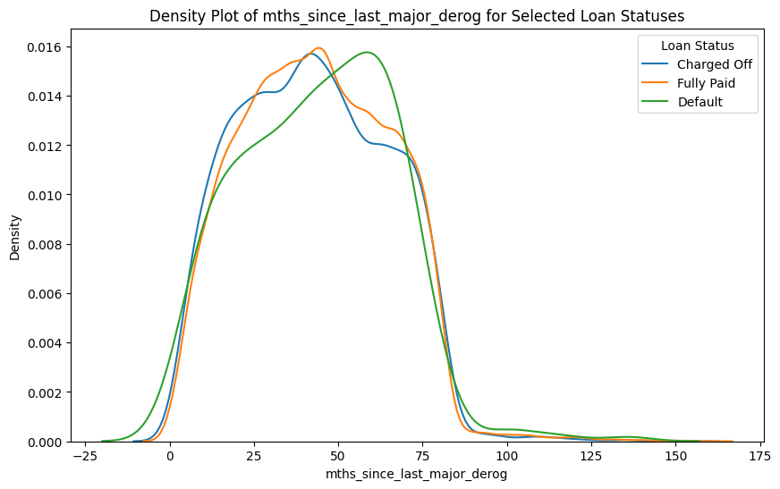
Derogatory for Fully Paid, Charged Off, and Defaulted Loans
Pub_Rec: Total amount of Derogatory on record
mnths_since_last_major_derog: Months since the most recent 90-day or worse rating
Notes:
Andrew

Slide 15
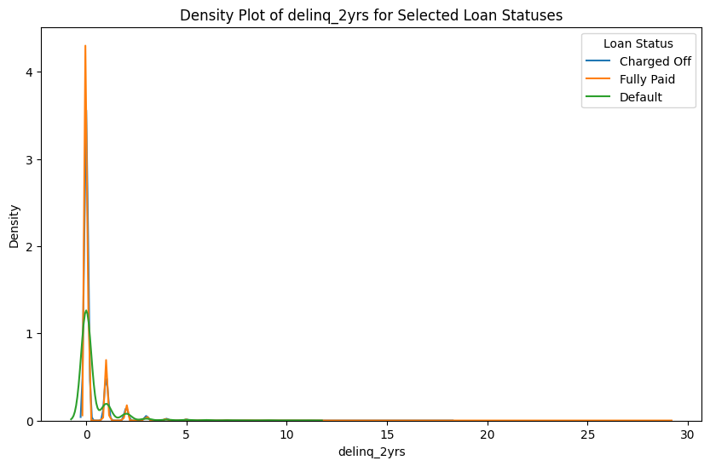
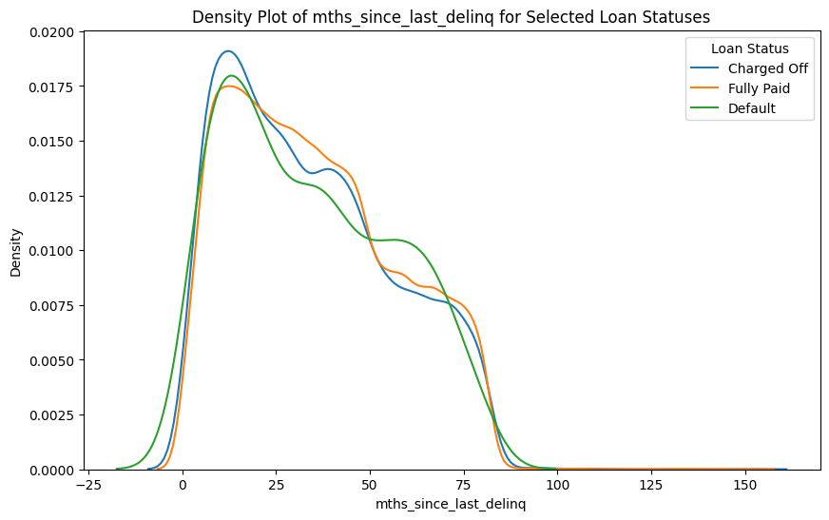
Delinquincy for Fully Paid, Charged Off, and Defaulted Loans
Delinq_2yrs: The number of 30+ days past-due incidences of delinquency in the borrower's credit file for the past 2 years
mths_since_last_delinq: The number of months since the borrower's last delinquency.
Notes:
Andrew

Slide 16
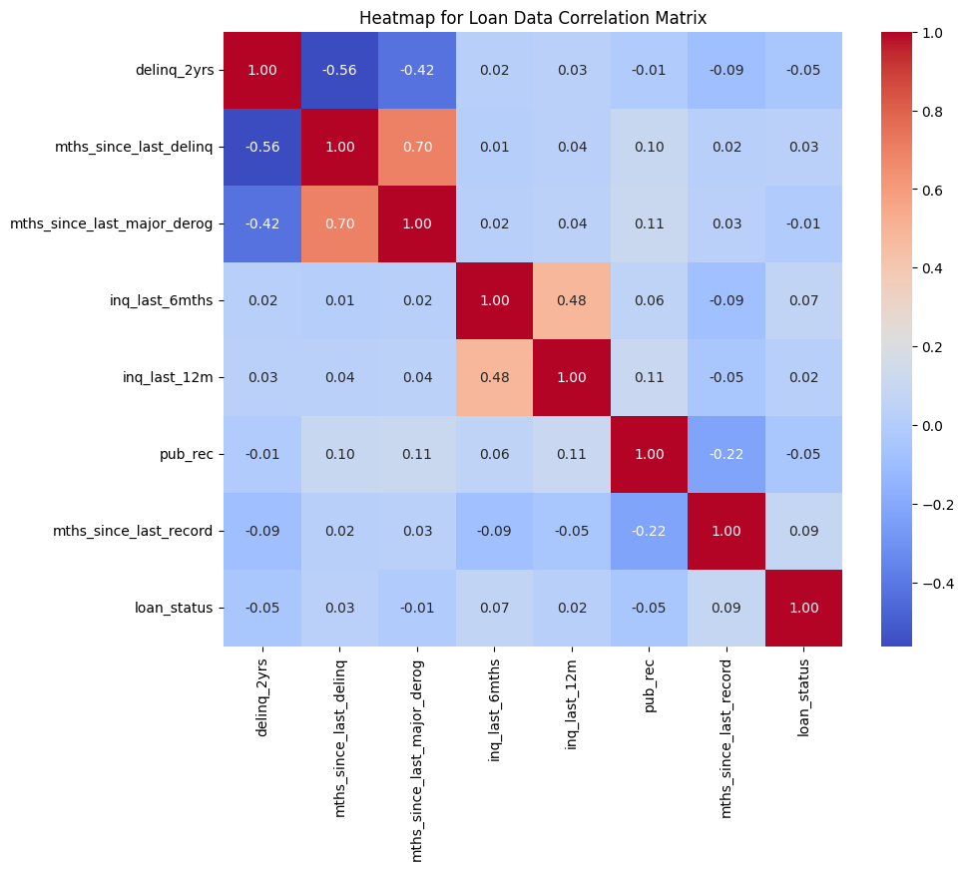
Loan Correlations to Fully Paid Loans
Notes:
Andrew

Slide 17
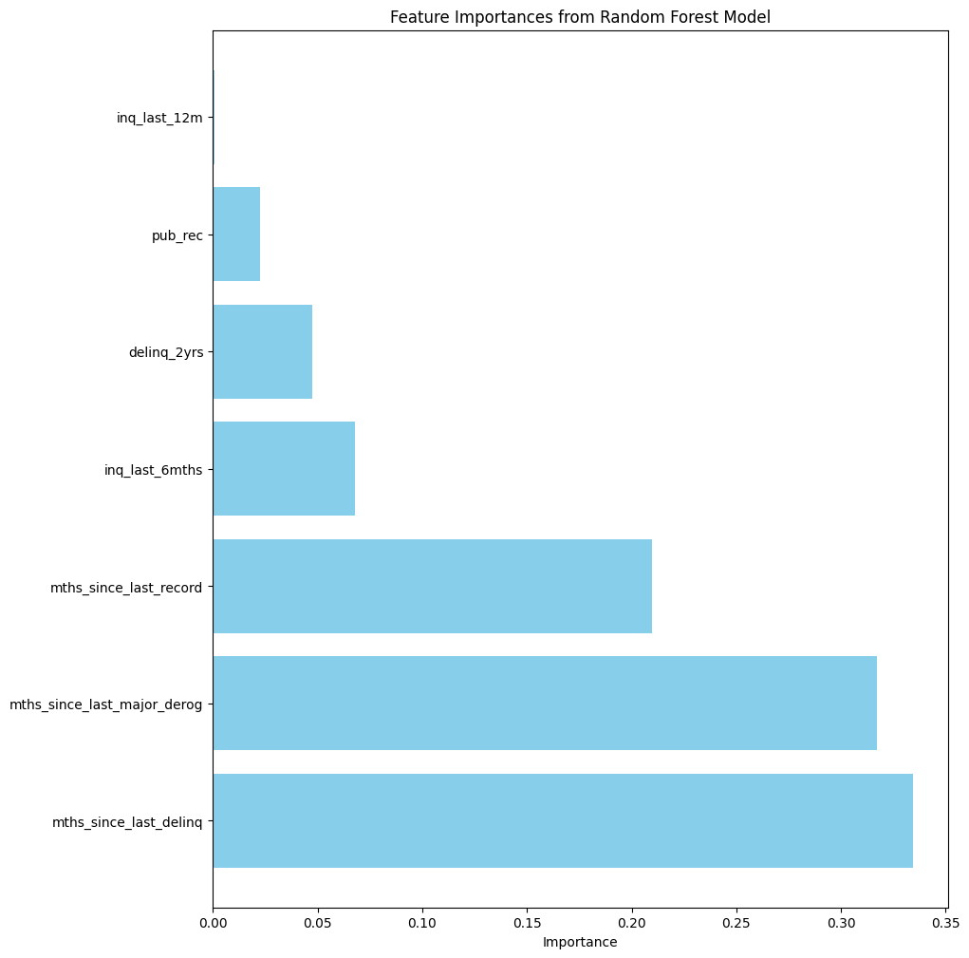
Loan Random Forest Model for Fully Paid, Charged Off, and Default
Conclusion: The history of a borrower isn’t enough by itself to predict if a loan will fully be paid off, but the biggest indicators are last delinquency and derogatory
Notes:
Andrew

Slide 18
Personal Demographics
Notes:
Ethan Styles

Slide 19
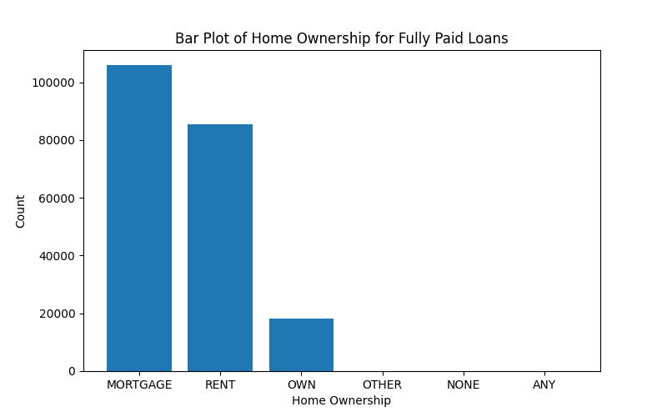
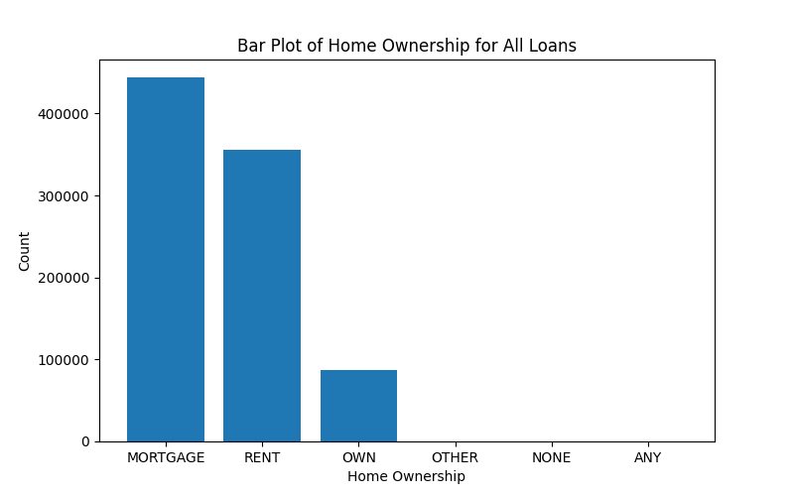
Homeownership
Practically the same distribution
Notes:
Ethan Styles

Slide 20
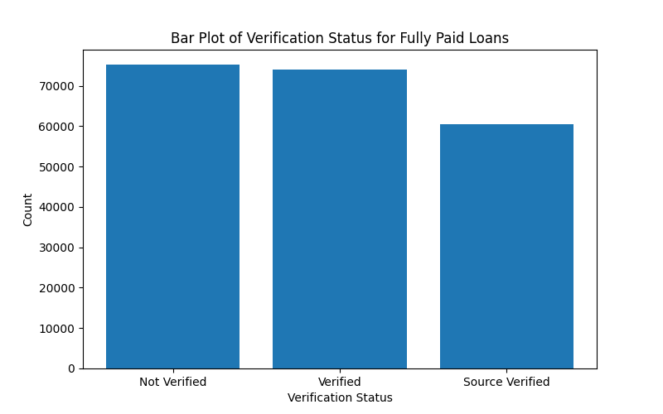
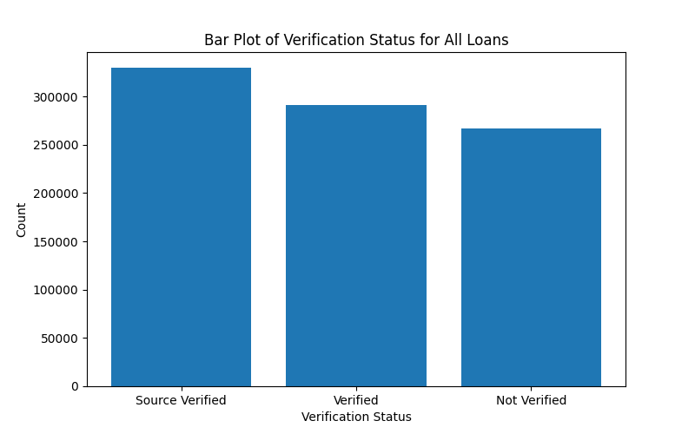
Verification Status
Notes:
Ethan Styles

Slide 21
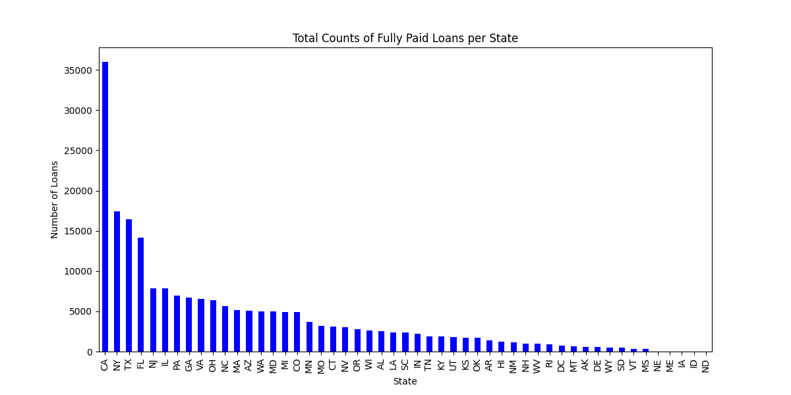
State
Notes:
Ethan Styles

Slide 22
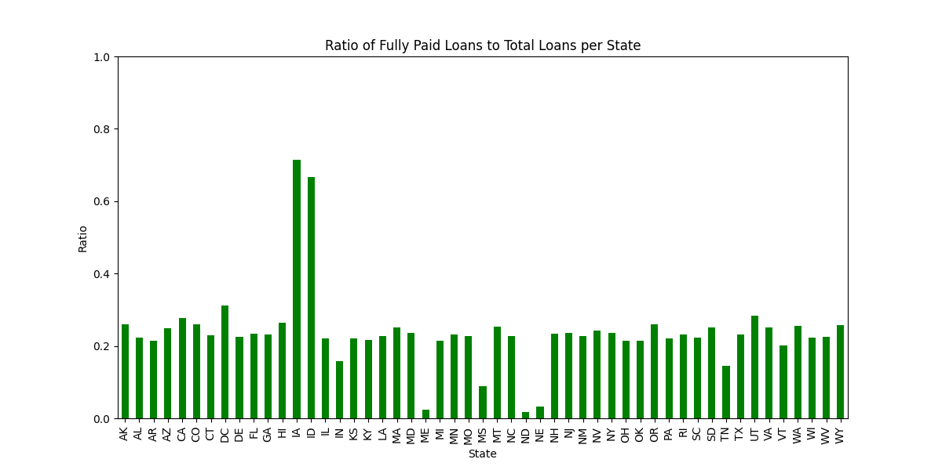
Notes:
Ethan Styles

Slide 23
Financial Indicators
Notes:
Ethan Ericson

Slide 24
Procedure
Goal: Determine if the following areas impact a borrower’s ability to fully pay off their loans.
Annual Income
Debt to Income
Employment Length
Notes:
Ethan Ericson

Slide 25
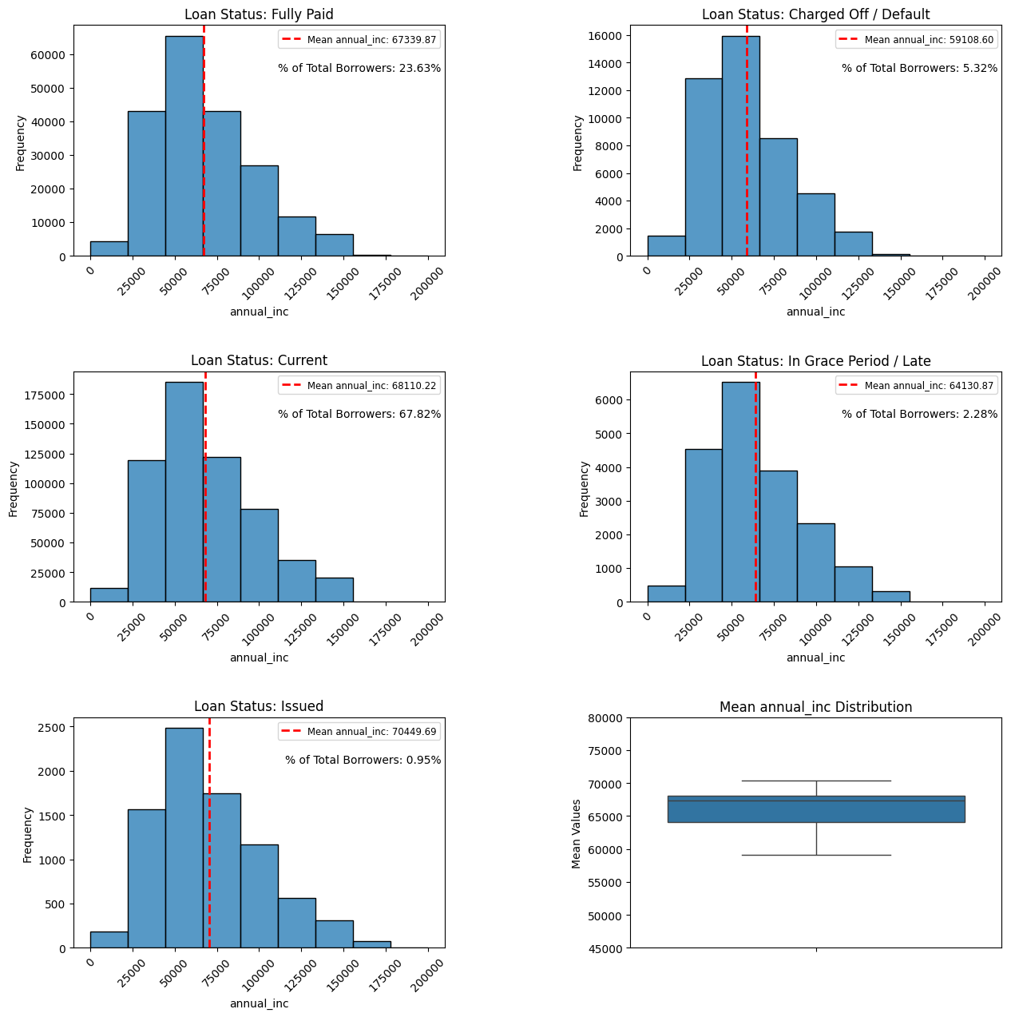
Annual Income
Income Disparity: There is around a $8,000 difference between the mean annual incomes of borrowers who fully pay and those who are charged off/default. This indicates annual income does have an impact.
% of Total Borrowers: Indicates the relative weights of loan status groups
Mean Distribution: Indicates how spread out the mean annual incomes are between different loan statuses.
Notes:
Ethan Ericson

Slide 26
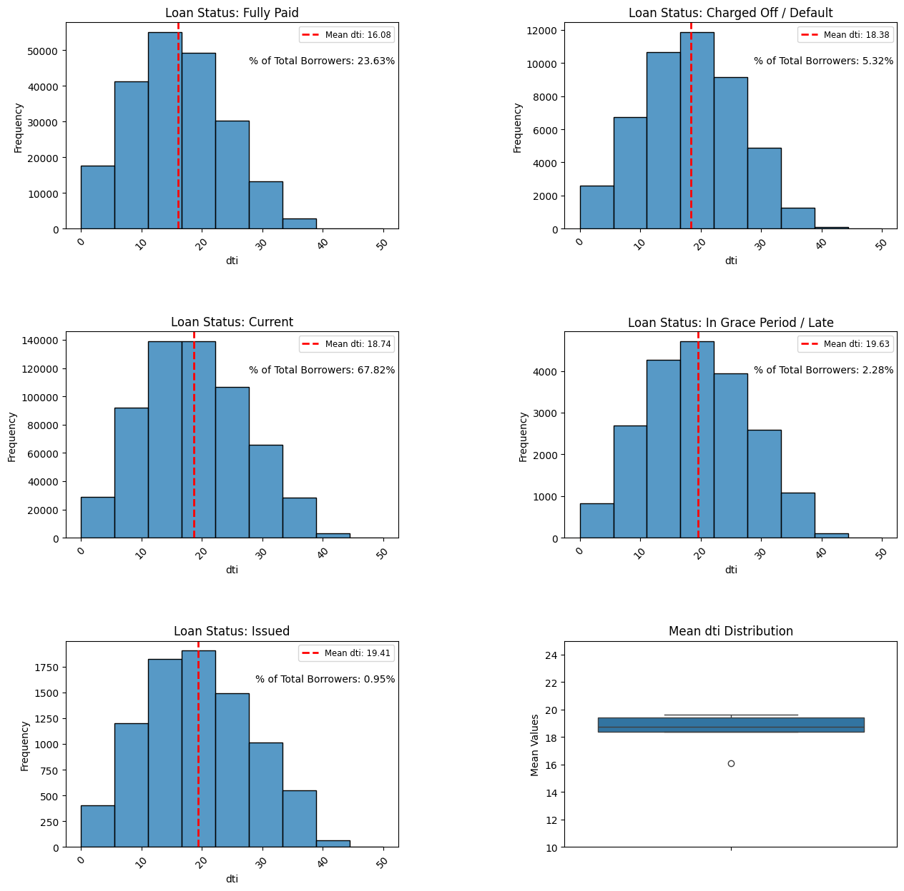
Debt to Income
DTI Disparity: There is about a 2% difference in mean DTI between borrowers with fully paid off loans and borrowers who had been charged off / defaulted, indicating that DTI has an impact.
Mean Distribution: Small scale of DTI units makes the mean DTI distribution look clustered, but in reality, there exist significant differences, especially between the fully paid status and charged off / defaulted status.
Notes:
Ethan Ericson

Slide 27
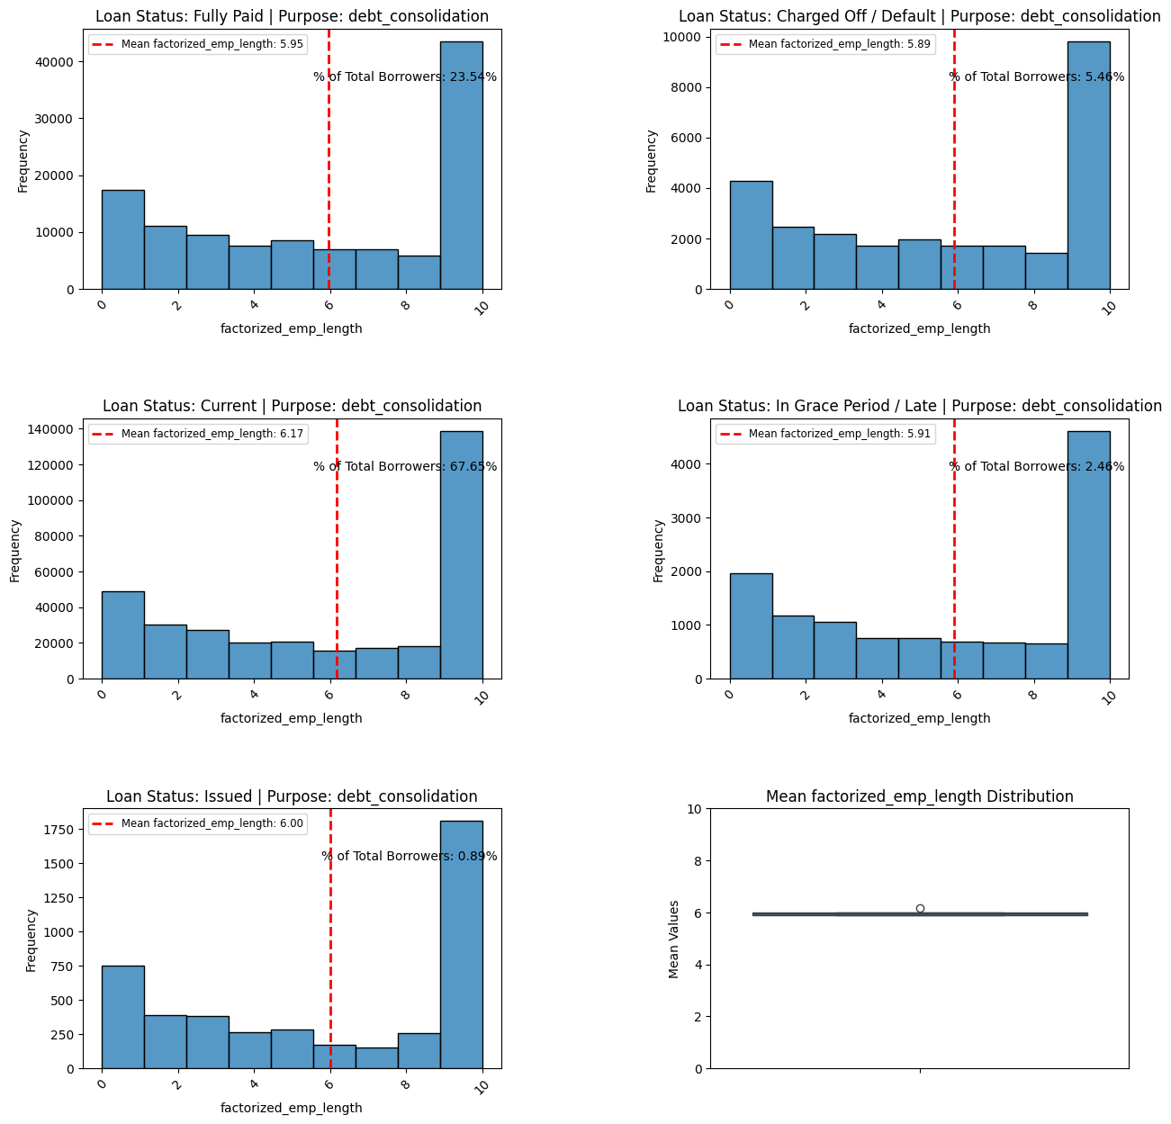
Employment Length
Lack of Disparity: Looking at employment length, which is measured in years, we see barely any difference in the means between status, indicating employment length is not a strong predictor of a borrower being able to fully pay off their loan.
Notes:
Ethan Ericson

Slide 28
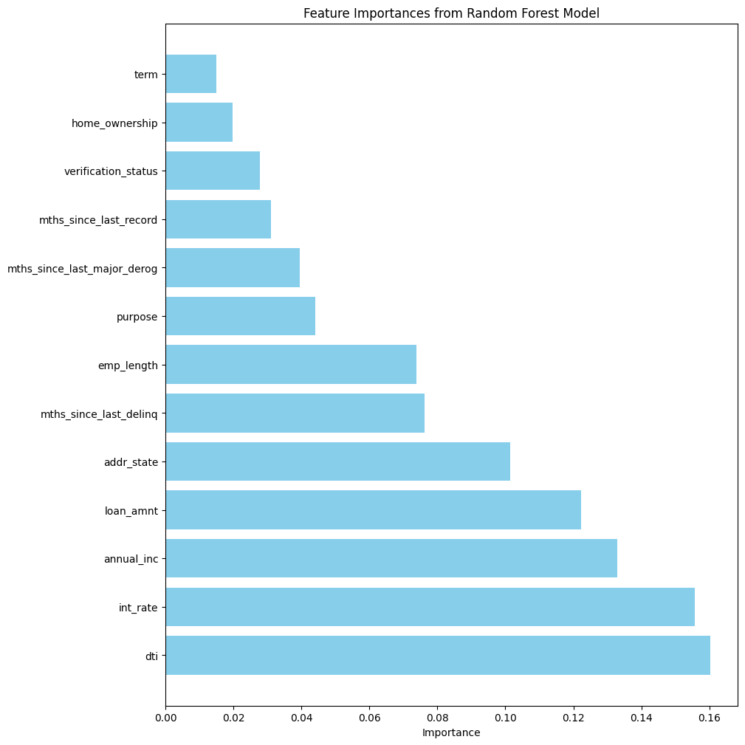
Machine Learning
Attributes from all our EDAs using the Random Forest Model
Notes:
Andrew

Slide 29
“Good” Borrower Characteristics
These characteristics are the relative thresholds that indicate a borrower will fully pay off their loan.
Loan Indicators
Payment History: High Repayment Rate (95%)
Loan Interest: Is fine with a reasonable Interest rate (29 - 40%)
Loan Amount: Ask for a moderate Loan Amount ( avg. $10,000)
Credit Indicators
Months since the last Derogatory: 48+ months
Months since the last Delinquency: 24+ months
Demographic Indicators
State: Varies by Population
Less Verified the better
Financial Indicators
Annual Income: $60,000 or more
Debt to Income: Within 1% of 16% DTI – This can change based on annual income
Notes:
Everyone

Slide 30
Recommendations & Conclusions
Marketing Department
Use our defined “Good: Borrower Characteristics to market loans to groups more likely to pay them off.
Revolving Lines of Credit Department
Use our characteristics as benchmark for current borrowers.
Notes:
Ethan Ericson

Slide 31
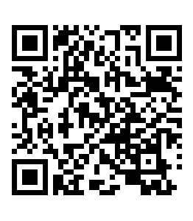
Questions?

